Slide 1
Pixel 3 GMS App Investigations
Part 4: Google Photos
Notes:
https://digitalcorpora.s3.amazonaws.com/corpora/mobile/android_10/Non-Cellebrite%20Extraction/Pixel%203.zip

Slide 2
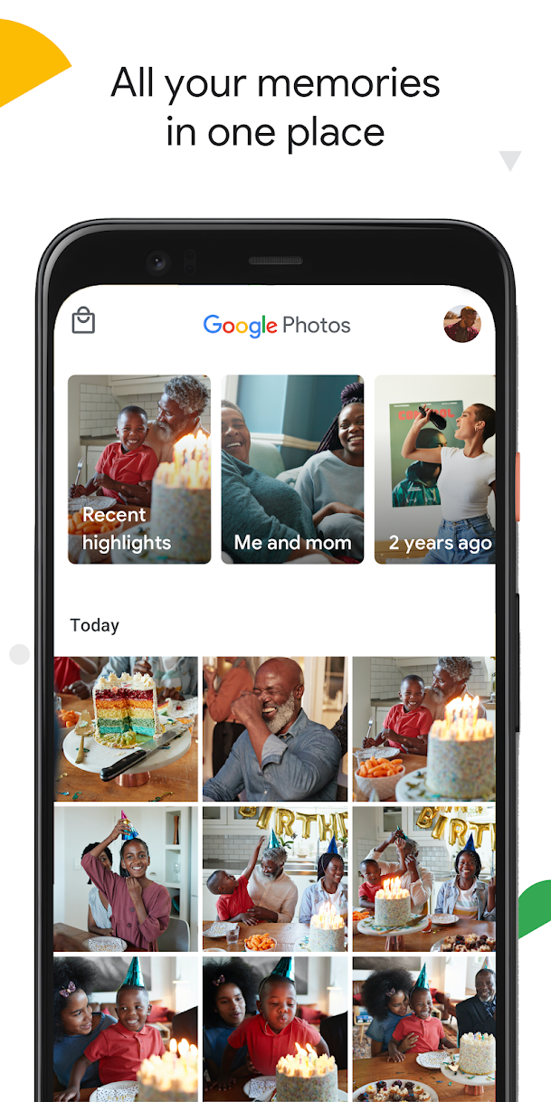
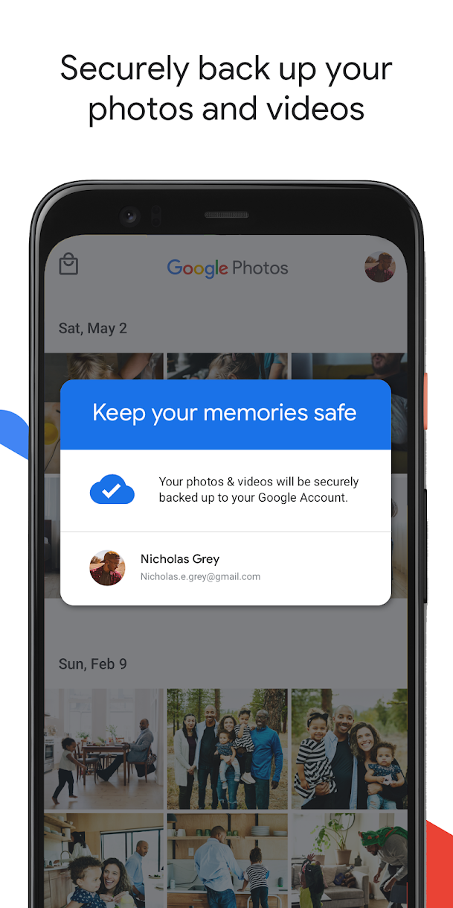
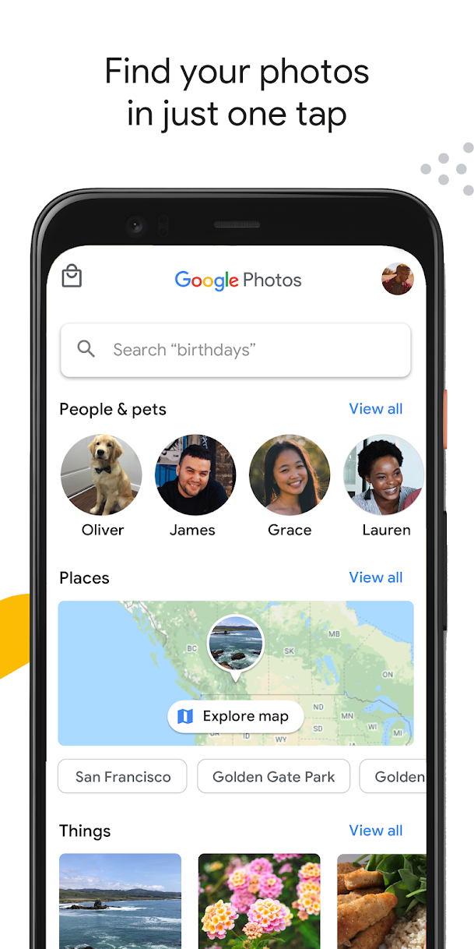
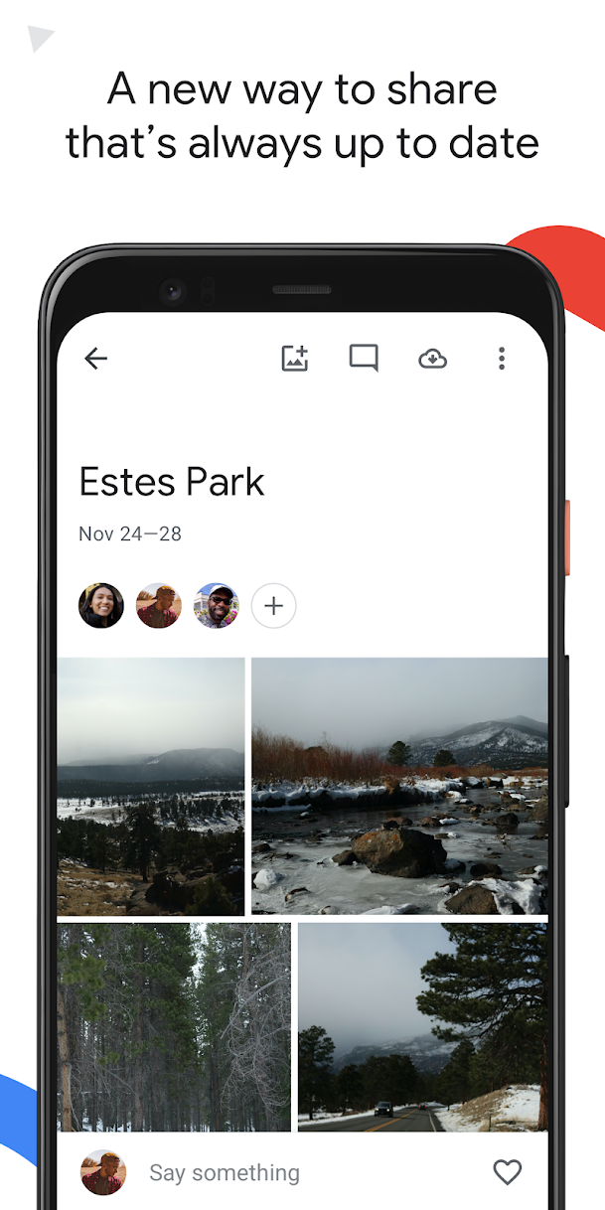
What is Google Photos ?
a cloud-based photo and video storage and sharing service

Slide 3
Google Photos functions
Cloud Storage
Automatic Backup and Sync
Search and Organization
Advanced editing suite
Shared albums
Memories and Creation
Face and Object Recognition
Cross-Platform Availability

Slide 4
How to know if backup is enabled?
Any photos that you take from a device with backup enabled will be saved to your Google Account.
If you edit and save a photo on your phone, the photo will look the same on Google Photos
Shared Preferences is the folder where such information gets stored.
Allow activities and applications to keep preferences.
Store user-specified configuration details, such as user-specific settings, keeping the user logged into the application

Slide 5
Why it's important to look for back up?
Backup is crucial in an investigation because:
Suspect may have deleted data related to the case but took back up before deleting
If the system crashes, data can be recovered quickly from backup
Backup is done to save something important
Timestamps of the backup can be useful

Slide 6
Forensic questions related to photos
What photos are saved?
location and timestamps
What location has the most photos?
Did a suspect receive the photos from someone or were they clicked using the phone?
Can we deduce the suspect's relation to people in the photos/videos?
Any deleted photos?

Slide 7
a. what photos are saved?
Step 1: Find the database where photos are stored
Step 2: Find the table that contains the photos
Step 3: Find the column contains the photos
Step 4: Find the photos in a cell

Slide 8
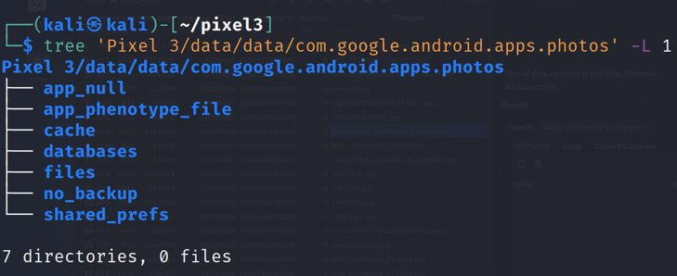
Step 1: Find the database where photos are stored
Show Google Photos package structure
Notes:
Cmd: tree 'Pixel 3/data/data/com.google.android.apps.photos' -L 1

Slide 9
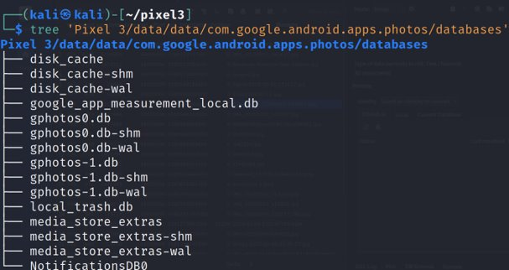
Show Google Photos database
Notes:
Cmd: tree 'Pixel 3/data/data/com.google.android.apps.photos/databases'

Slide 10
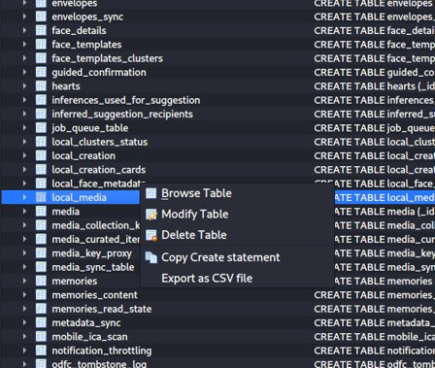
Step 2: Find the table that contains photos
Open the database (gphotos-1.db)
Local_media table contains photos
You can explore other tables as well based on what information you need
Notes:
Cmd: sqlitebrowser 'Pixel 3/data/data/com.google.android.apps.photos/databases/gphotos-1.db'

Slide 11
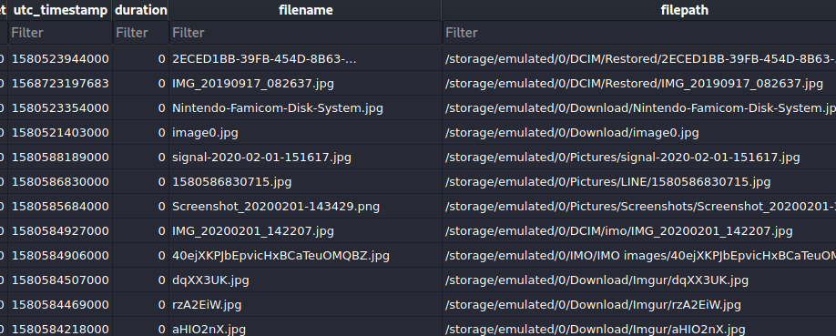
Step 3: Find the column that contain photos
Open the local_media table

Slide 12

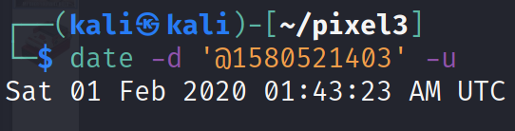
Solution (download images)
Image0.jpg
Date when image was clicked

Slide 13
Step 4: When was the last backup completed?
Find shared_prefs folder
Check each file

Slide 14
Show Google Photos package structure
Notes:
Cmd: tree 'Pixel 3/data/data/com.google.android.apps.photos' -L 1

Slide 15
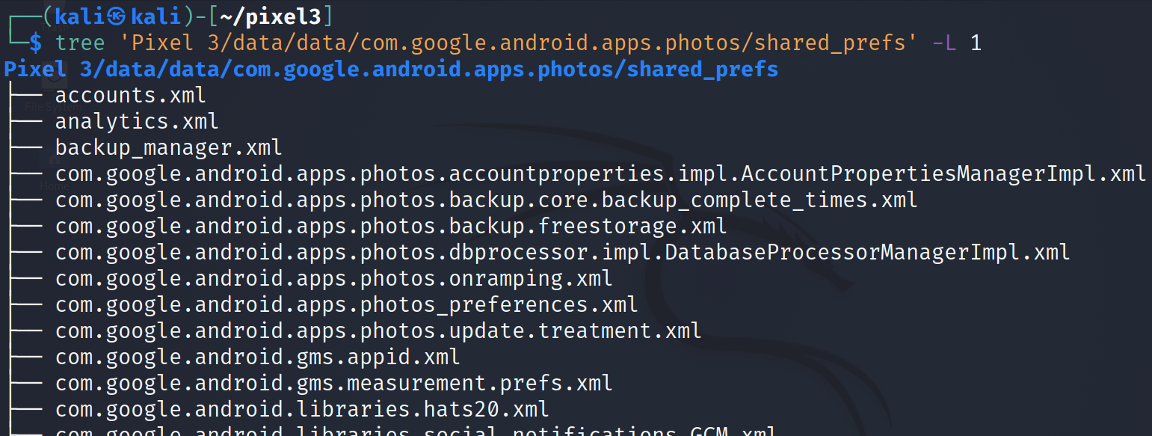
Show shared_prefs
Notes:
Cmd: tree 'Pixel 3/data/data/com.google.android.apps.photos/shared_prefs' -L 1

Slide 16
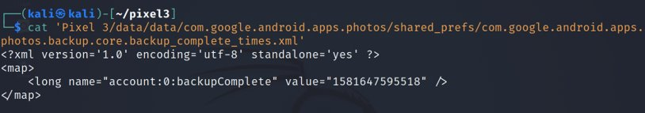
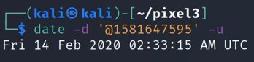
Open the file
This is the time when the account back up was done
Solution: timestamp
Notes:
Cmd: cat 'Pixel 3/data/data/com.google.android.apps.photos/shared_prefs/com.google.android.apps.photos.backup.core.backup_complete_times.xml'
Date cmd: date –d '@1581647595' -u

Slide 17
Assignment
Can you answer the rest of the questions?

Slide 18
To summarize
Understand the application
Locate the application package
Look at the application directories
Go to the databases directory
Open gphotos-1.db
Explore local_media table
Go to the shared prefs folder
Find the the file that contains back up information

